Slide 1
Class 13: Lasso
MGSC 310
Prof. Jonathan Hersh

Slide 2
Class 13: Outline
Regularization Intuition
Lasso Regression
Comparing Ridge vs Lasso
ElasticNet

Slide 3
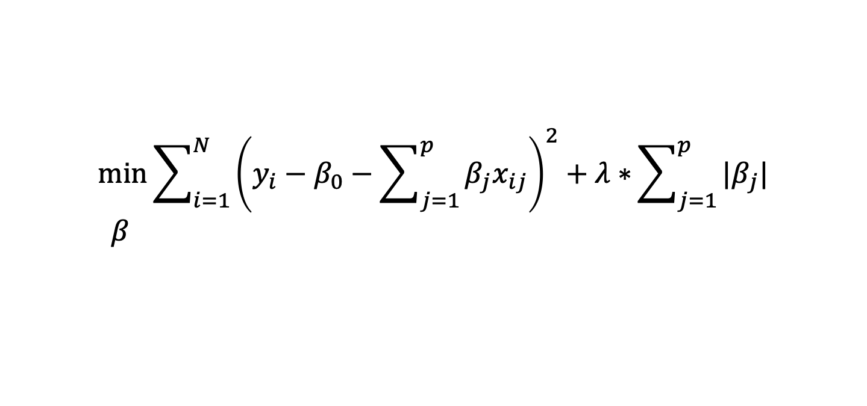

Lasso Estimator
Absolute value of coefficients
Lambda “tuning” parameter
Lasso Regression:
A type of linear regression that introduces a penalty on the absolute values of coefficients in the model.
Penalty leads to some coefficients becoming exactly zero, effectively selecting a simpler model.
Useful when:
Feature selection is needed, as it can set some coefficients to zero.
Model interpretability is a priority, by keeping only the most influential predictors.
Like Ridge, when the number of features exceeds the number of observations.

Slide 4
Lasso Estimator
Absolute value of coefficients
Lambda “tuning” parameter
Recall: the penalty term in Ridge regression was 𝛃_{j}², now we have a penalty term of |𝛃_{j}| !
Like Ridge Regression, when 𝝀 = 0, we simply have linear regression
Like Ridge Regression, when we increase 𝝀 we reduce model complexity
UNLIKE Ridge Regression, as we increase lambda we also get something special and new…

Slide 5


Lasso Regression Idea
Lasso minimizes the residuals plus lambda times the absolute value of the slope coefficients
Lasso coefficients are still smaller than OLS coefficients
Y
Lasso still accepts a little bias for (hopefully) less variance
X

Slide 6
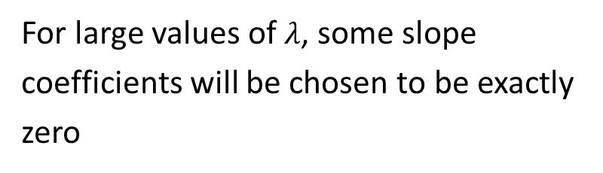


Key Lasso Property: Variable Selection
e.g. if we set 𝝀 = 10, maybe 𝛃₁ != 0 but 𝛃₁^{𝝀=10} does = 0 !
In other words, we can effectively remove certain 𝛃 from our equations with high enough penalties!
Lasso becomes a variable selection algorithm at high 𝝀.
Y

Slide 7






Ridge Versus Lasso Penalty
Ridge penalty
Lasso penalty
Let’s pick an arbitrary value of s = 1
What do these look like graphically?

Slide 8





Ridge and Lasso Equations Redux
OLS residuals level curves
Suppose the optimal OLS beta is this point in black
Meaning, without constraints this point achieves a minimum of the residuals
We can represent that graphically as a series of contour lines where the black dot (OLS beta) is the minimum
Level curves farther from the OLS point are higher residuals

Slide 9
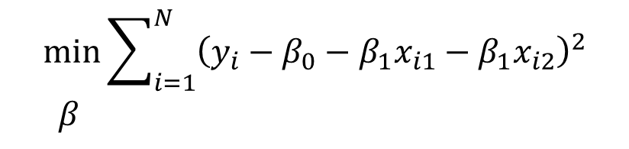


Ridge and Lasso Equations Redux
OLS residuals level curves
Graphically what the ridge equation is asking is: “find the lowest residual level curve while staying within the blue circle”
That is the level curve tangent to the blue line
Ridge
subject to

Slide 10

Ridge and Lasso Equations Redux
OLS residuals level curves
Graphically what the Lasso equation is asking is: “find the lowest residual level curve while staying within the green diamond”
That is the level curve tangent to the green line
Lasso
subject to

Slide 11
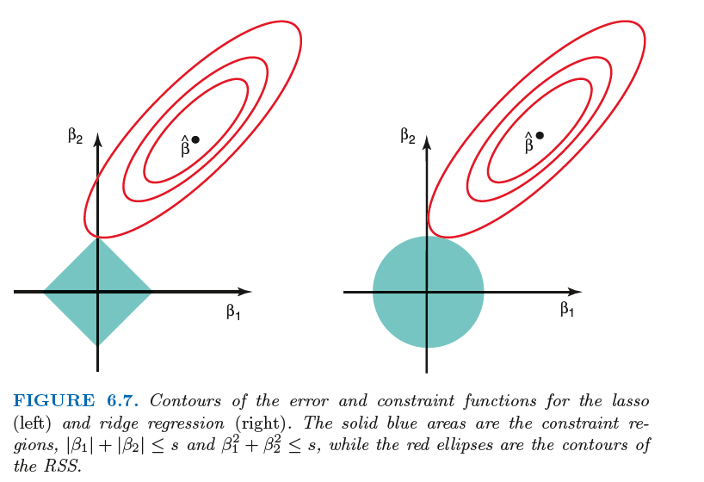
Ridge and Lasso Equations Redux
Lasso acts as a variable selector because the point of tangency for Lasso is often such that one of the variables (here beta_1) is zero
Ridge does not have this property, and we see there’s still some small value for beta_1 in the right plot

Slide 12


Ridge versus Lasso
Use Lasso when the “data generating process” (DGP, how the data is really formed) is sparse
What is a sparse DGP?
Only a few variables really matter!
Ridge should be used when many variables matter a little

Slide 13
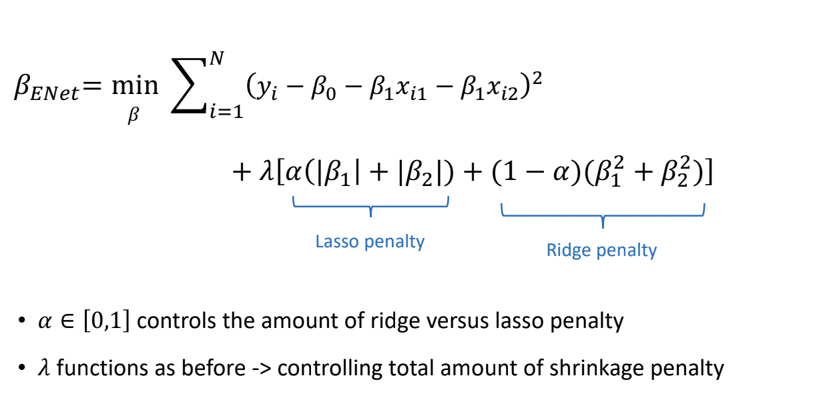
Why Choose? ElasticNet Uses Both Ridge and Lasso Penalty
Lasso penalty
Ridge penalty

Slide 14
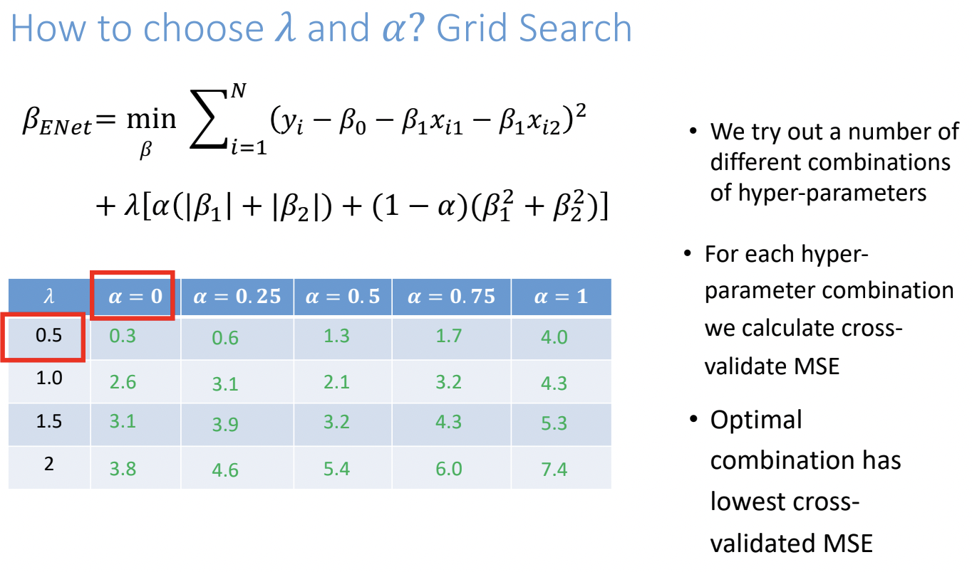
We try out a number of different combinations of hyper-parameters
For each hyper-parameter combination we calculate cross-validate MSE
0.5
1.0
1.5
2
0.3
0.6
1.3
1.7
4.0
2.6
3.1
2.1
3.2
4.3
3.1
3.2
4.3
5.3
Optimal combination has lowest cross-validated MSE
3.9
3.8
4.6
5.4
6.0
7.4

Slide 15
To the code!
To the code!

